Slide 1
Lab 5 - Plotly
INFO 201

Slide 2
Assignment 6
Due 11/08
Content
Plotly & Mapping
Working with real world data

Slide 3
Assignment 5
How did we feel about it?
Questions?
Feedback?

Slide 4
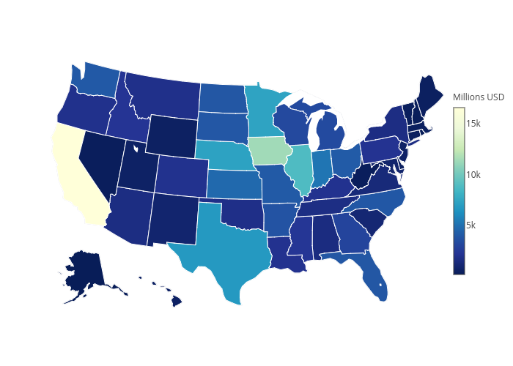
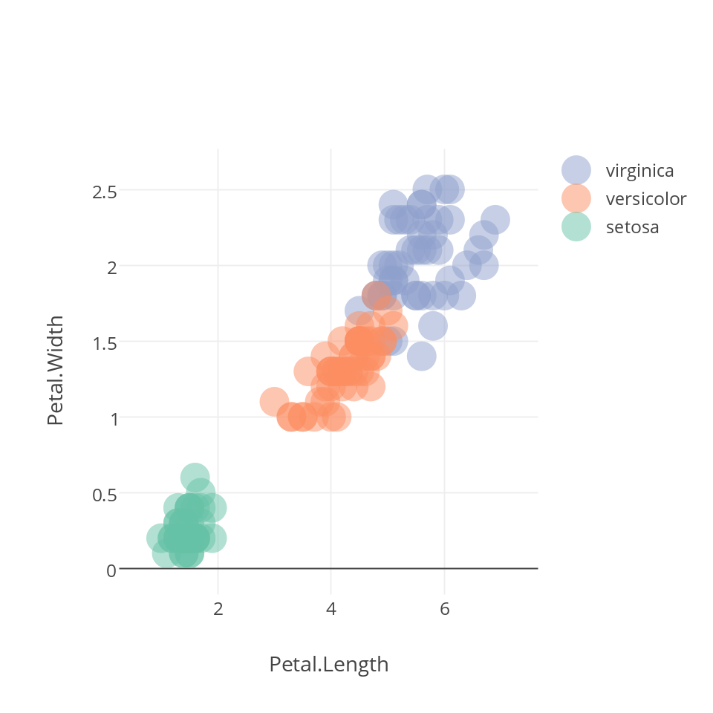
Plotly!
Documentation for R
Review of Plotly
Types of Charts
Maps
Scatter plots
Bar charts
Use real data!

Slide 5
Let’s try it out
Open up R
Paste this in:
See it work!
library(plotly)
set.seed(100)
d <- diamonds[sample(nrow(diamonds), 1000), ]
plot_ly(d, x = ~carat, y = ~price, color = ~carat,
size = ~carat, text = ~paste("Clarity: ", clarity))

Slide 6
Now your turn...
Go to m12-plotly on GitHub
Exercise 4

